Slide 1
Day 1: R for Open & Reproducible Science
David Souto
School of Psychology and Vision Sciences
Notes:
Short intro on the importance of open and reproducible science - organization of the workshop
We are going to mention levels … as a way to cater for people at different stages / who have different needs. Level's 2-3 go beyond what we can cover here. You could attempt exercises at this level if you have time left, but the idea is that Level 1 provides you with a basic and perfectly serviceable understanding of the topic for our purpose.
Introducing the RStudio interface (20')
<!-- TBD: could produce a video and live-code; can show setwd() tips with ".." and ".", at times opening a file does not set up the working directory correctly,
can do getwd() to figure out where you are and use ".." to go back one or "./03_session" for instance to go one folder down-->

Slide 2

Instructors team
David Souto, Lecturer, Open Science Team Lead
Samantha Tyler, Postdoctoral researcher, UoL & Bham
Anna Nowakowska, Early Career Fellow, UoL
Tamara Gheorghes, Lecturer, UoL
Mahmoud Elsherif, Postdoctoral researcher, UoL
Acknowledgements
Midlands Integrative Biosciences Training Partnership
Improving Research Community Builder Award (University of Cambridge)
to Samantha Tyler, Faye Balcombe, Mahmoud Elsherif, Callum Hunt, Milena Rota

Slide 3
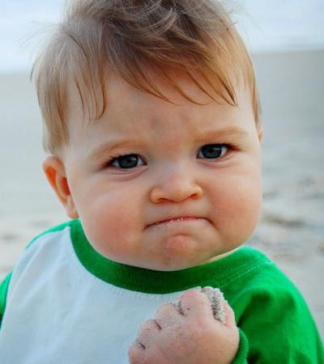
Why this workshop?
Provide PhD students & early career researchers with basic tools to tackle challenges to reproducible science:
Knowledge
Statistical reasoning
Practical skills
Notes:
Four years of promoting OS within department told us we need a focused workshop rather than repeating things across the year
I feel the gap in that we observe between knowing what to do and what should be done is related to “exactly” how to go about it in very practical terms. This will be one focus of this workshop. What are the tools and how to use them efficiently. I take a usability approach (what things I find enjoyable and efficient to use) rather than an idealistic approach: e.g. produce fully reproducible papers requiring you to configure RStudio learn git, etc. I will similarly avoid a maximalist approach to statistics with the goal of building intuition to allow you to plan good experiments and interpret them, pointing to good places where you can deepen this knowledge when needed.

Slide 4
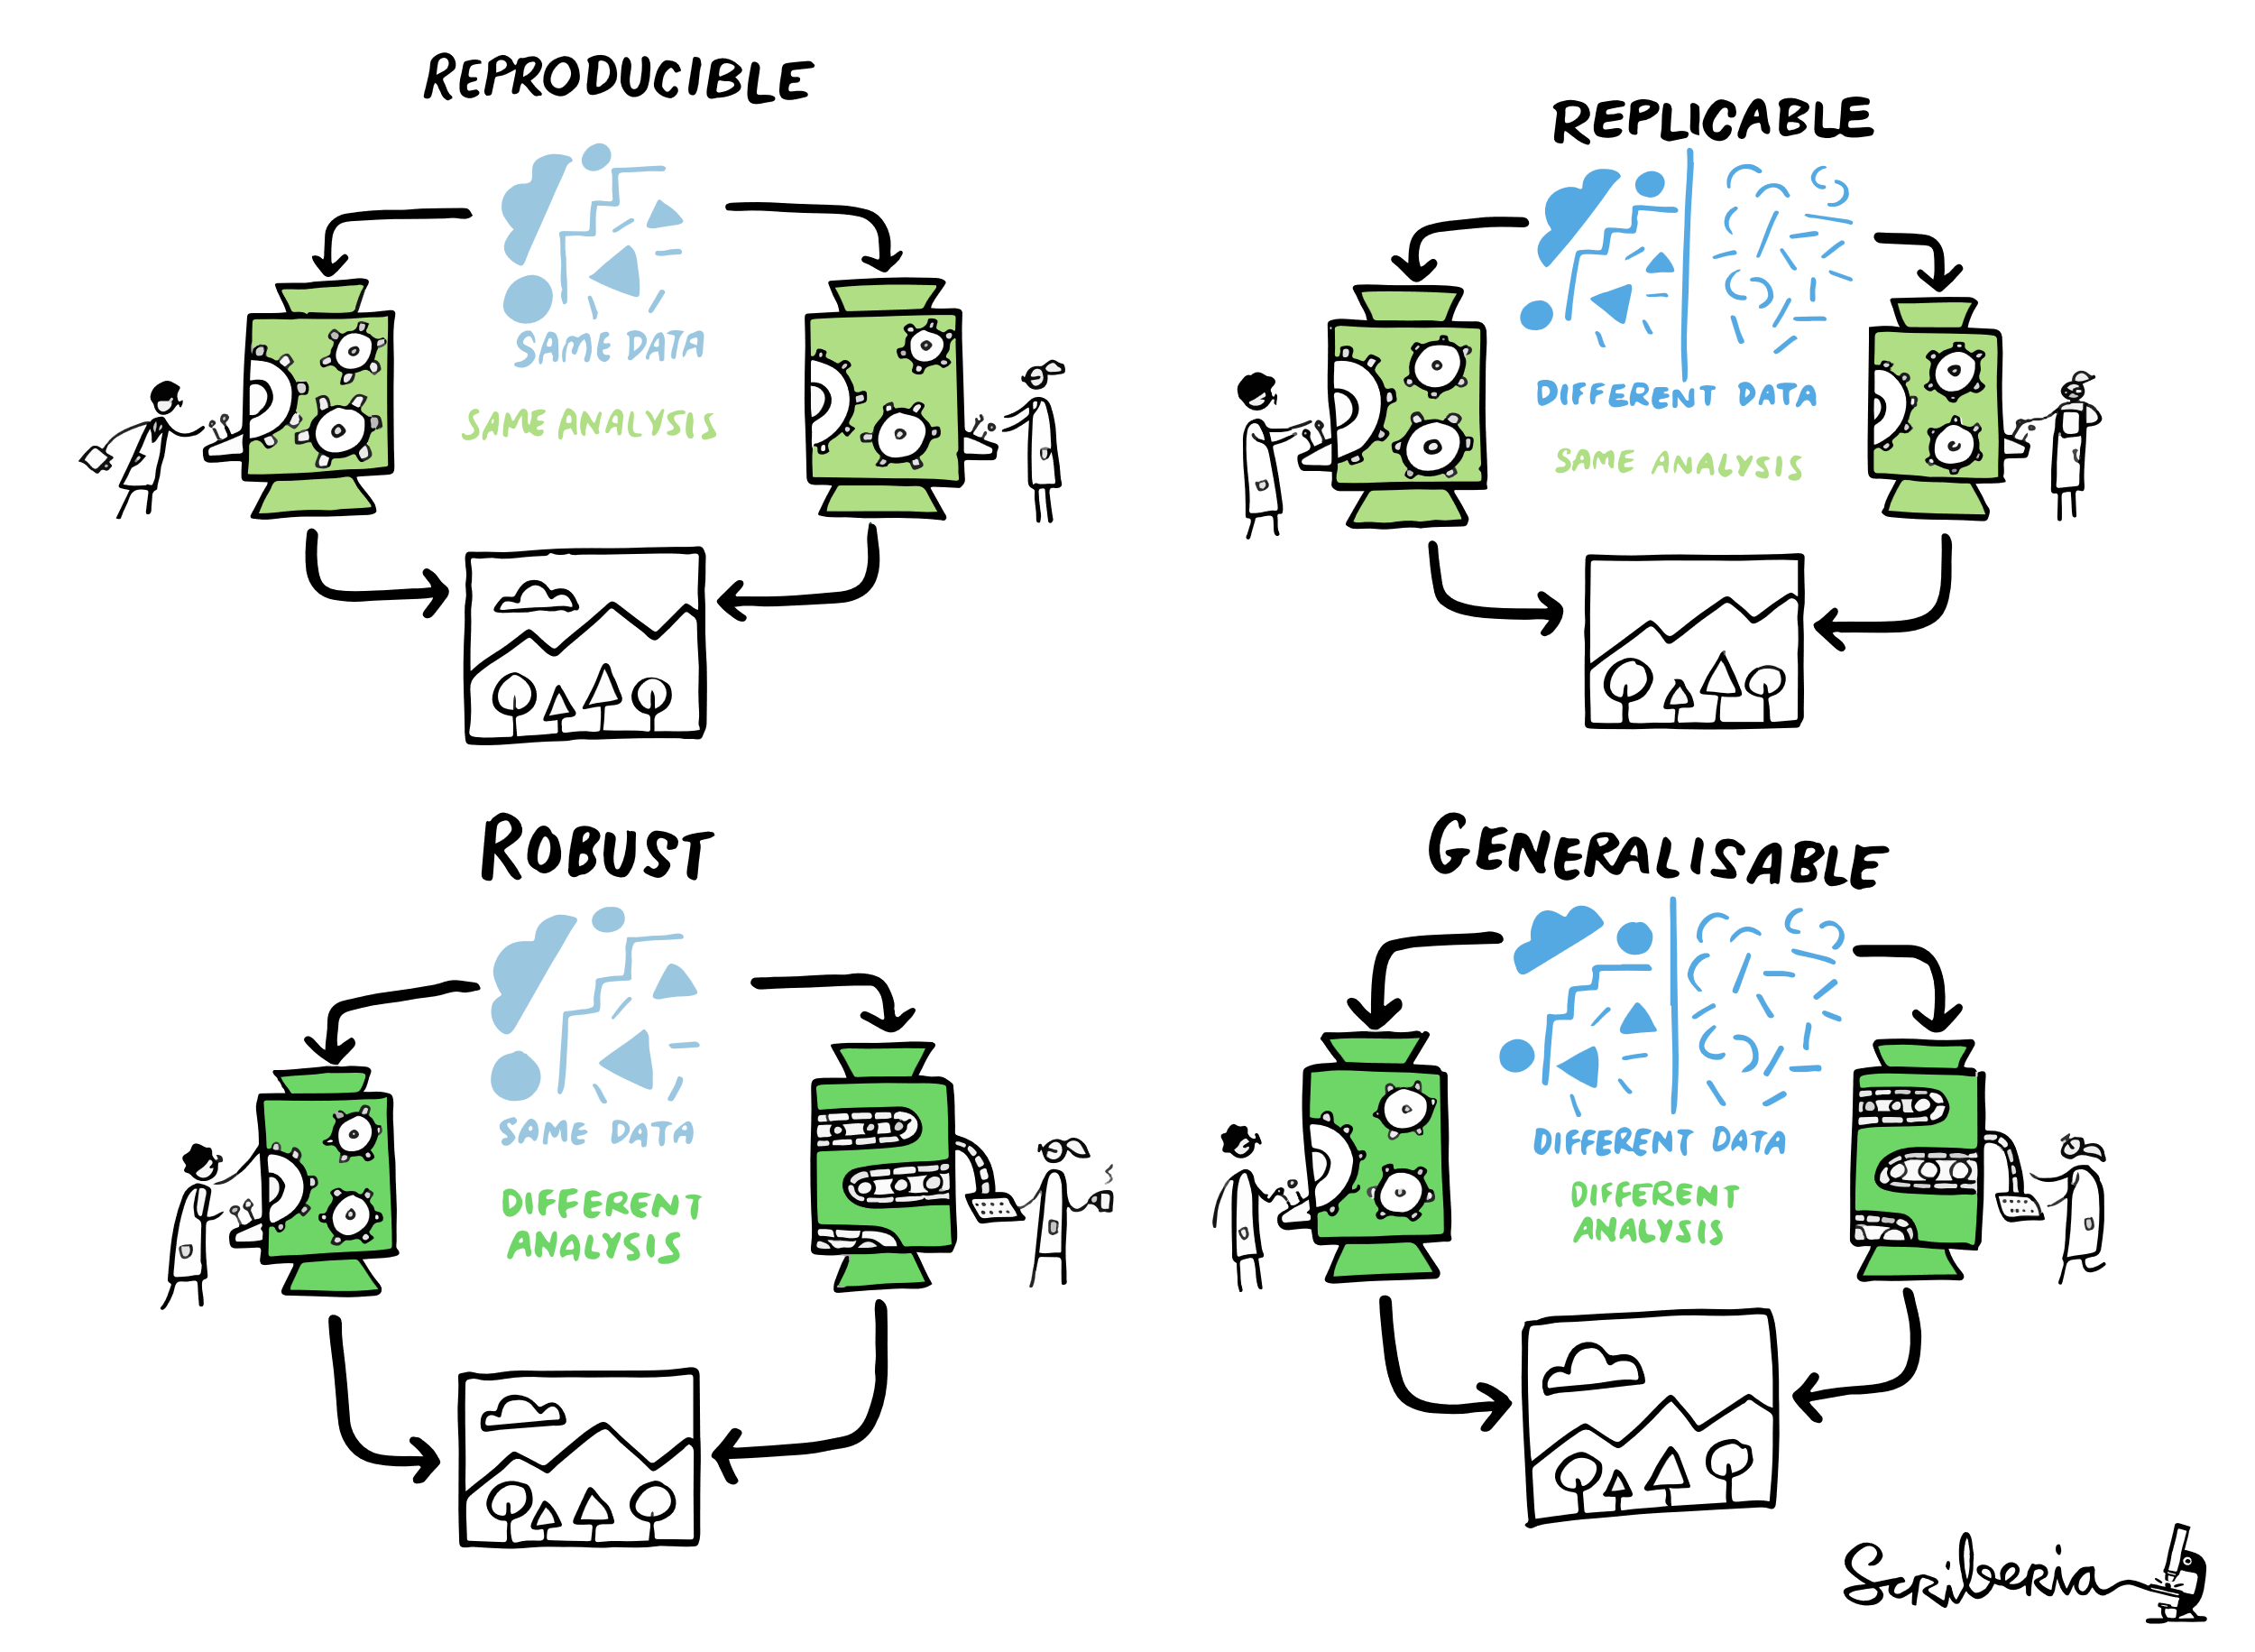
Reproducible Science
The Turing Way project illustration by Scriberia. Used under a CC-BY 4.0 licence. DOI: The Turing Way Community & Scriberia (2024).
Notes:
In The Turning Way definition reproducible refers strictly to being able to get the same result from the same analysis with the same data. We are not going to be so restrictive here in our definition. We’ll focus all those aspects in some way or another. Turing Way Handbook: https://book.the-turing-way.org/

Slide 5
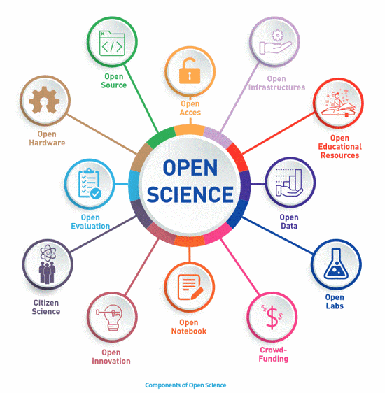
Open Science / Scholarship

Slide 6
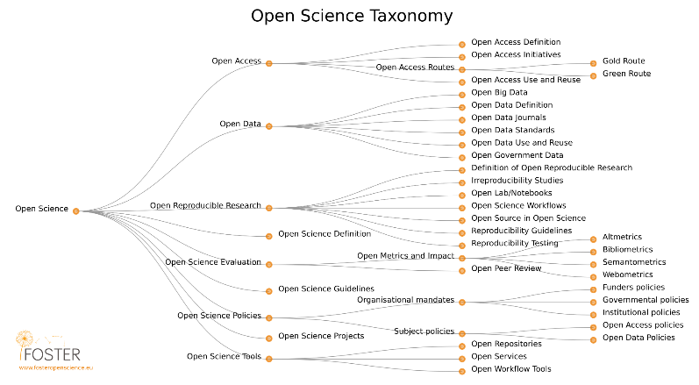
Wide implications
Notes:
We are focusing on the third brank

Slide 7
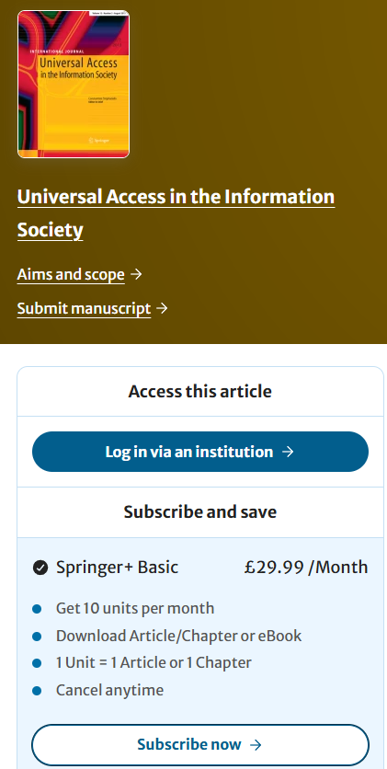
Universal access to research
Papers are incomplete summaries
Reproducing / replicating a finding presumes access to detailed procedures, data, materials
Even access to the (freely contributed) paper isn’t a given

Slide 8
Access to outputs, data and materials
Peer review
publication
Post-print
Private code & data
Pre-registration
Pre-print
Peer-review
Post-print
Publication
Public code and data
Universally
accessible
Universally
accessible

Slide 9
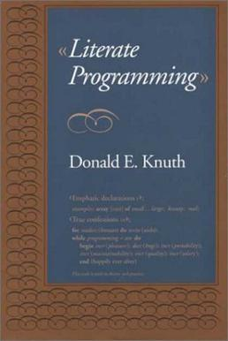

Literate programming
Markdown
*.md
R extension:
Rmarkdown
*.Rmd
Notes:
We are going to do this from the get go; the medium is the message here
Literate programming is a 40 year-old concept put forth by a giant of computer science; write code to be understood by humans not to suit the constraints of the machine

Slide 10
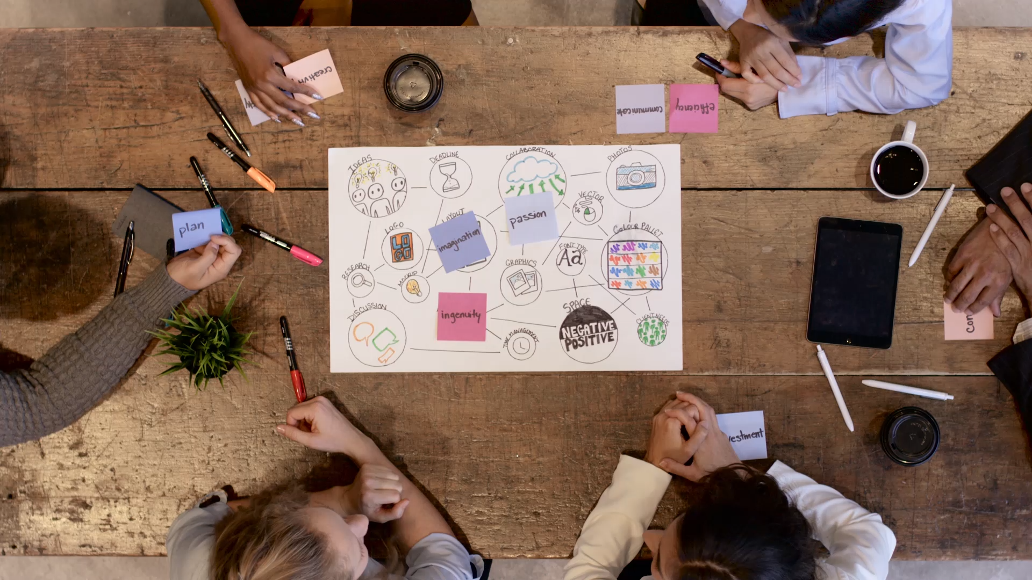
How to interact with Worksheets & intro to RStudio interface
Demo

Slide 11
Levels
Level 1: What you need to know
Level 2: Desirable, not essential
Level 3: Maybe useful to some people

Slide 12
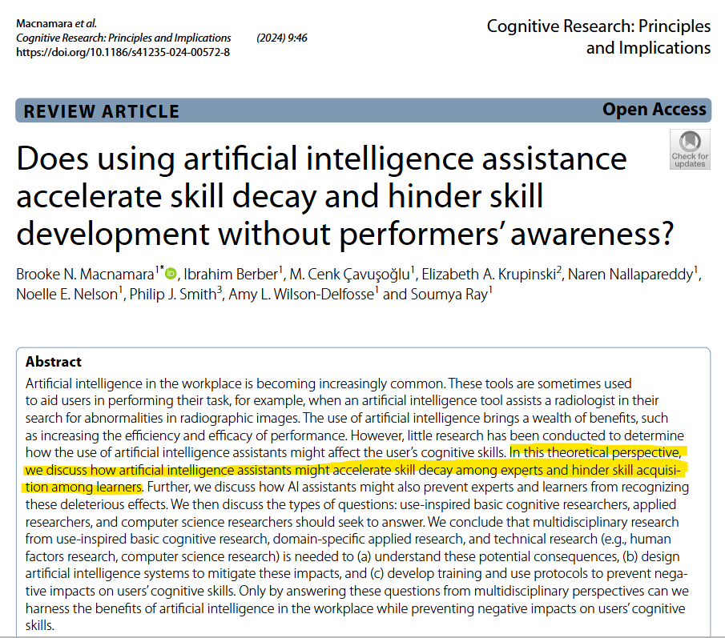
Use of AI
Productivity: AI can dramatically boost your coding productivity.
Learning: over-reliance on AI may lead to cognitive skill decay
Ethical Considerations: reliability, plagiarism, bias, environmental impact

Slide 13
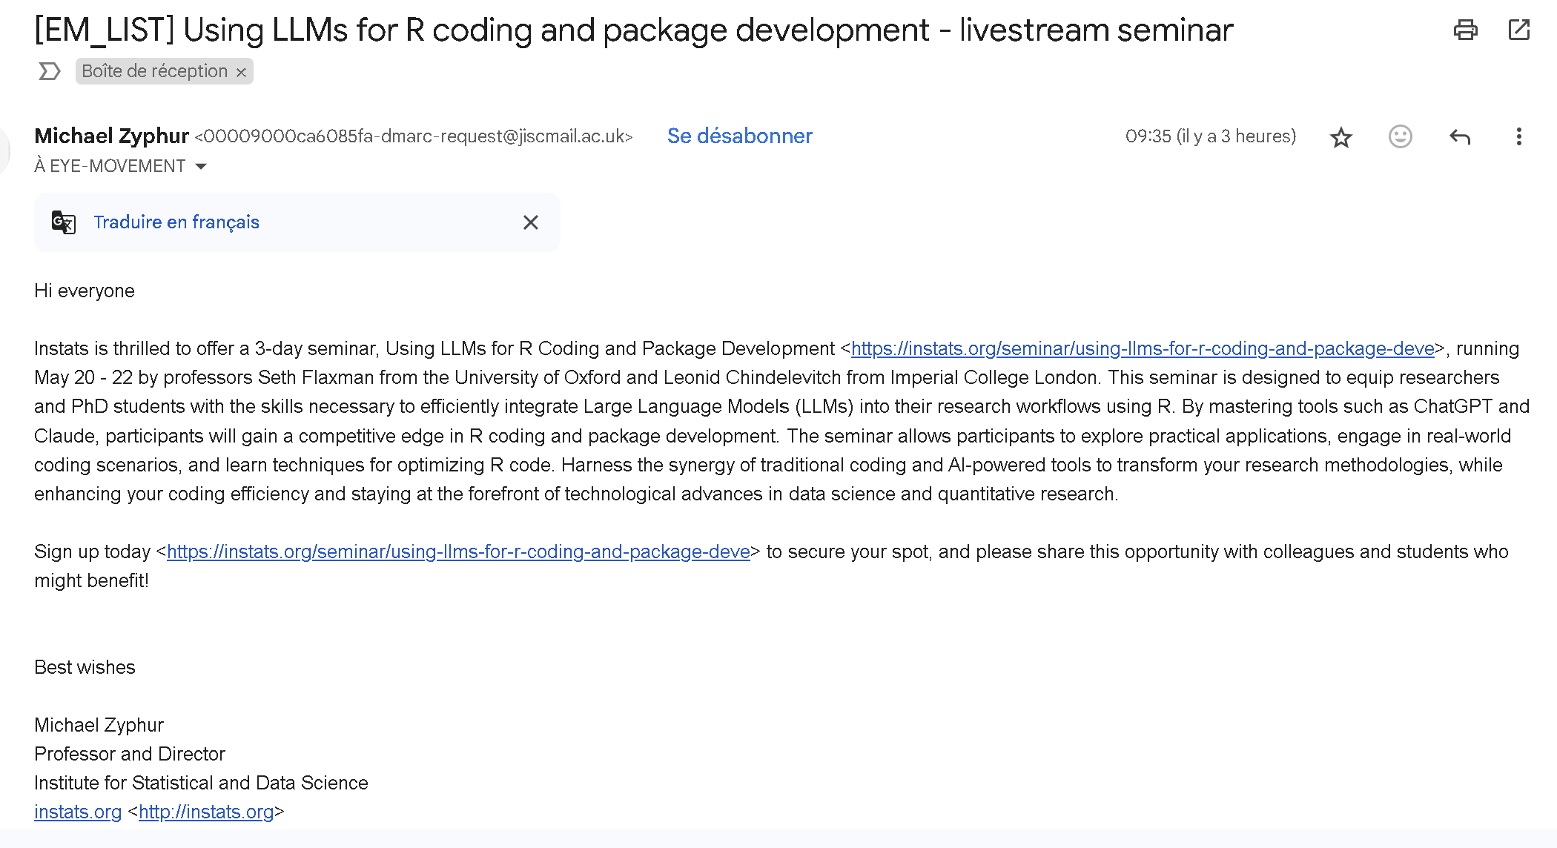
Use of AI

Slide 14
Introduction to R & RStudio
Exercise 1.1 (15’): Workshop Packages
Exercise 1.2 (10’): Organizing files
Exercise 1.3 (15’): Finding errors in scripts and functions
Exercise 1.4 (15’): Computational reproducibility
Exercise 1.5 (15’): Documenting projects with README files
Notes:
Try things and find out
Explore optional examples if there is time

Slide 15
Data wrangling
• Exercise 2.1 (20’): Loading datasets
• Exercise 2.2 (25’): Using pipes to manipulate datasets
• Exercise 2.3 (25’): Interactive reporting

Slide 16
Data Visualization
• Exercise 3.1 (20’): GGPlot logic
• Exercise 3.2 (20’): Displaying all data
• Exercise 3.4 (20’): Publication quality plots

